Slide 1

Headline Verdana Bold
Say hello world
Deloitte Tech Experience – Tech Challenge
What impact will you make?
www.deloitte.com/pt/careers

Slide 2


Contents
6
Generative AI & Retrieval-augmented Generation
Use Case Description
Challenge
Challenge Rules
Pitch Guidelines
Technical Instructions

Slide 3
Deloitte Tech Experience
6
Generative AI
Generative AI is a subset of artificial intelligence focused on the ability of machines to create outputs across various modalities (e.g., text, images, audio, code, voice, video).
It uses Large Language Model (LLMs), such as OpenAI’s GPT, trained on massive amounts of data to understand human communication and natural language.
These models can also be fine-tuned to become specialized for industry/ domain-specific solutions using fit-for-purpose AI application frameworks (e.g., NVIDIA nemo).
LLMs are usually trained on large amounts of general-purpose data. However, the model may also have contextual information, usually non-public, real-time, or purpose-specific data, with a technique called Retrieval-augmented generation (RAG).
RAG is an AI framework that combines the strengths of traditional information retrieval systems (such as search and databases) with the capabilities of generative LLMs.

Slide 4





Deloitte Tech Experience
6
Retrieval-augmented Generation (RAG)
High-level RAG architecture
Question
Question + Context
Answer
Retrieval
(semantic search)
Context
(chunks)
Libraries and components:

Slide 5

Deloitte Tech Experience
Retrieval-augmented Generation (RAG)
CHATBOT ENGINE
The user asks a question (also known as user prompt)
The question is converted into a vector using the Embedding Model
The vector is indexed in the database to be compared with vectors from the knowledge base
The retrieved similar text chunks are used as context to answer the user prompt
4
5
6
7
8
9
USER
PROMPT
LLM
AI ASSISTANT
RESPONSE
5
6
VECTOR-BASED KNOWLEDGE
1
2
3
Stored Vectors
…
Stored vectors considered the most similar to the prompt vector
All types of Documentation
Embedding Model
Private Knowledge Base
Each document is split into multiple text chunks
Chunks are transformed in vectors
The vectors (embeddings) are indexed in a vector database
Prompt vector

Slide 6


6
Deloitte Tech Experience
Use Case Description – Context and Goal
GreenPath Solutions Inc. is a fictional startup dedicated to promoting environmental sustainability and empowering young adults to make informed decisions about climate change. The company focuses on leveraging technology to educate and engage users to promote impactful actions toward a greener future.
This use case aims to develop a GenAI-powered chatbot, EcoGuide, that provides tailored climate change information and sustainable product recommendations.
Knowing Deloitte’s extensive experience on efficiently helping companies to implement GenAI-powered technologies, GreenPath Solutions Inc. is requesting Deloitte to support on the following:
Implementing an interactive chatbot that utilizes GenAI RAG architecture to deliver accurate and personalized climate change information and recommends EcoGuide products when requested.

Slide 7
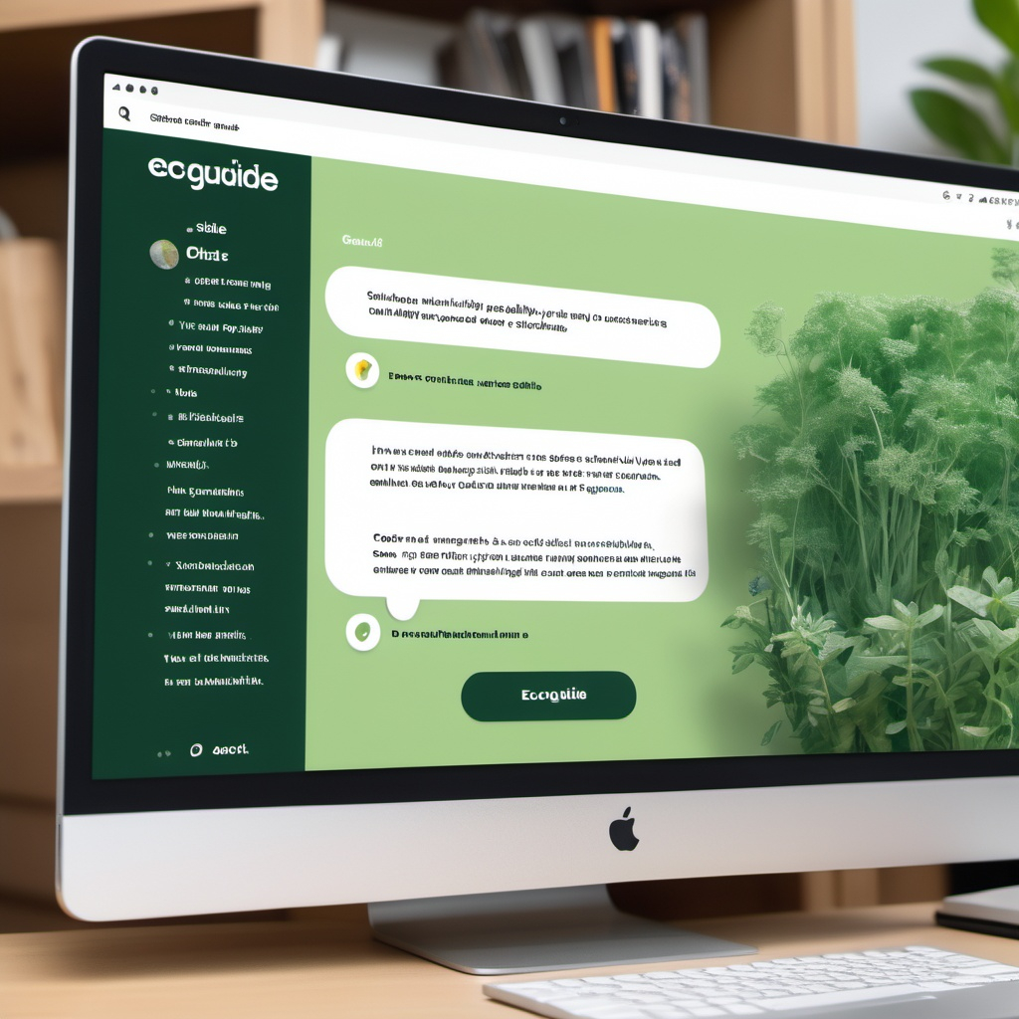

Deloitte Tech Experience
Challenge – What to Do
Challenge Overview
Minimal requirements
Develop the EcoGuide Chatbot using a RAG architecture that uses a knowledge base with climate change articles to deliver accurate and personalized climate change information.
Chatbot should be able to answer questions related to the text of the climate change documents (PDFs, HTML, DOCX)
Chatbot should use the provided vector database FAISS
Chatbot should have a frontend
Chatbot should support follow-up questions (conversation history)
Answers must be accurate and relevant
Challenge Tasks
Excellence Takeaways
Answer questions made by the user using the information available in the provided scientific reports, articles, and papers;
Make personalized recommen-dations for sustainable practices and eco-friendly products.​
Responsive and intuitive chatbot interface
Answer questions whose answers are in images within the provided documents
Use as input documentation other formats besides PDFs
Identify and reference the source documents used to answer each question
Image Generated with OpenArt
Be creative and good luck!

Slide 8
Deloitte Tech Experience
Challenge – Provided documents
The chatbot answers and recommendations must be based on a subset of documents. These following documents will be shared with you:
Corporate Standard Frequently Asked Questions [HTML] – This document contains FAQs about the carbon emissions disclosure standards published by the Greenhouse Gas (GHG) Protocol.
The Greenhouse Gas Protocol Corporate Accounting and Reporting Standard [PDF] – This document provides a step-by-step guide for companies to use in quantifying and reporting their GHG emissions.
Climate Action Tracker Decarbonizing light-duty vehicle road transport [PDF] – This document provides updated 1.5ºC compatible benchmarks for the transport sector.
Climate Change An Overview [DOCX] – This document provides an outline of the issues around Climate Change and an analysis of the threats and challenges faced by indigenous people, UN agencies and others.
Sustainable Products [CSV] – This documents provides a list of sustainable products, eco-friendly products, and climate-related career opportunities.
Hint: you will need to parse and extract text from each of these document types and load it as part of the knowledge base. You will be provided with some examples, but you can also use ChatGPT to help you build some other features
Hint: to enable your chatbot to answer questions based on images and text, you will need to implement a multimodal RAG. There are multiple ways of doing it: search the internet or use ChatGPT to find suitable options

Slide 9
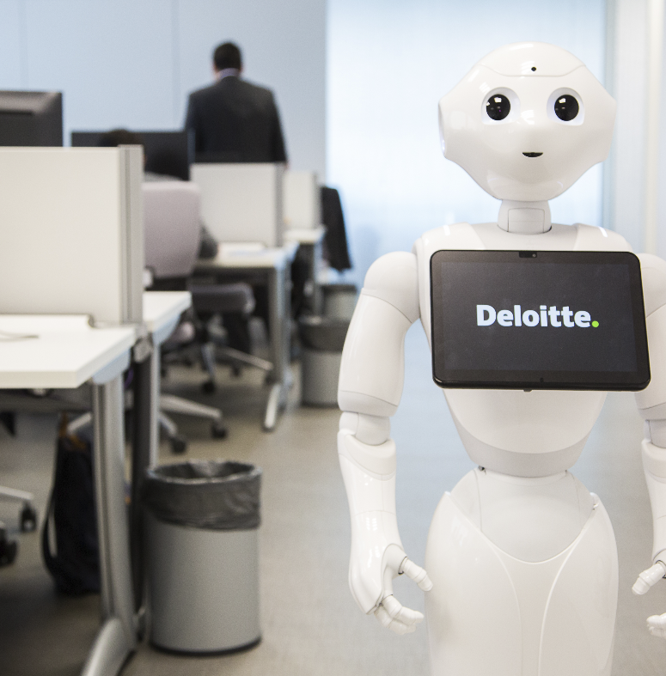
6
Deloitte Tech Experience
Challenge Rules
During the next 4 hours you will work in teams.
The main objective is to build a chatbot prototype. You will have at your disposal a set of assets, tools and a code base which will help you kick-start the project. Technical details are available in the Technical Instructions section.
At the end, each team will present their ideas and prototype in a 10-minute pitch, supported by a PPT document.
Teams will be evaluated by the originality of the ideas, prototype, questions coverage and answer accuracy, quality of pitch and ability to work as a team.
Please ask for help to one of the technical experts in the room - be pragmatic on your asks.
The use of other Generative AI solutions (example ChatGPT) is not only allowed but encouraged as a mean to speed your developments.

Slide 10

6
Deloitte Tech Experience
Sample Questions
Your chatbot should be able to answer questions like the following:
What are the greenhouse gases?
How are indigenous people being affected by climate change?
What should be the percent reduction in global passenger car fleet emissions by 2050?
What are emission factors, and how are they determined?
What is the main problematic greenhouse gas and what are its causes?
I want to give a gift to someone living in France, with an item of clothing. What do you suggest?
Hint: make sure the answers to these questions are coming exclusively from the source documents and articles provided!

Slide 11





Deloitte Tech Experience
Pitch Guidelines
You will need to pitch your solution, the chatbot. For the pitch you can be as disruptive as you would like. Create a slide deck, do a live presentation any other way.
As a guideline, you pitch could follow To improve your success, make sure your pitch enthusiastically follow these topics:
Demo
Present your prototype (demo)
* 3,5 minute
Team
Don’t forget to rehearse the presentation!
Introduce your team
1 slide* – 1,5 minute
Approach
Solution
Your solution to the problem – Technical architecture
Journey
Describe your approach to solve the problem
Address the problem - Tell a story
1 slide* – 1,5 minute
1~2 slides* – 2,5 minutes
1 slide* - 1 minute
*The time and number of slides are indicative.

Slide 12
Deloitte Tech Experience
Technical Instructions
You will be given a starter-kit project in which you must base your developments. You will find this available on your Desktop.
Open the project in the IDE Visual Studio Code
Set up the environment and install the project dependencies – all steps are outlined in the README file.
A Generative AI RAG architecture is composed of the following modules / steps:
Data ingestion;
Chatbot initialization;
Retrieve the document to the user query;
Insert the retrieved information as context for both LLM and user query;
Record all user queries and LLM’s answers.
Hint: use the internet to search and understand more about RAG architecture chatbots

Slide 13
Headline Verdana Bold
Say hello world
Deloitte Tech Experience – Tech Challenge
What impact will you make?
www.deloitte.com/pt/careers

